Slide 1
MYSQL PROJECT
BY
THIRUTHAMIZHI T

Slide 2
SQL
SQL stands for Structured Query Language.
SQL is a standard language for accessing and manipulating databases.
SQL is used to perform operations on the records stored in the database, such as updating records, inserting records, deleting records, creating and modifying database tables, views, etc.

Slide 3
DBMS
Database management system is a software which is used to manage the database. For example: MySQL, Oracle, etc, are a very popular commercial database which is used in different applications.
DBMS provides an interface to perform various operations like database creation, storing data in it, updating data, creating a table in the database and a lot more.

Slide 4
DATABASE
A database is an organized collection of data, so that it can be easily accessed and managed.
The main purpose of the database is to operate a large amount of information by storing, retrieving, and managing data.
There are many databases available like MySQL, Sybase, Oracle, MongoDB, Informix, PostgreSQL, SQL Server, etc.

Slide 5
My SQL Main Commands
Create database (Create a New Database)
Show Database (View Databases)
Drop Database
Alter Database (Modify Database)
Create Tables
Show tables
Insert Values
Drop Table
Alter table ( For New Column Creation)
Alter Table Modify
Alter table Drop ( Drop the Column)
Alter table Rename (Rename the Table)
Update Table ( To change the Values)
Delete Statement

Slide 6
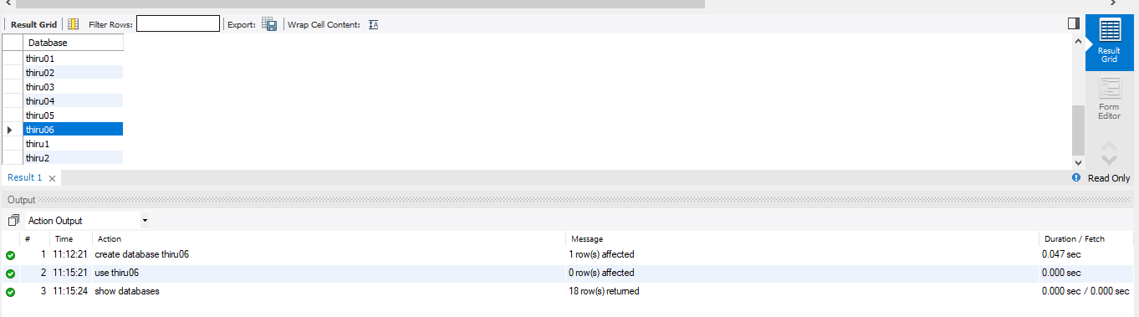
Create database
The create database statement is used to create a new SQL database.
Commands: Create database thiru06;
Show Database
Commands:
Create database thiru06;
Use thiru06;
Show databases;

Slide 7
CREATE TABLE
The CREATE TABLE statement is used to create a new table in a database
Commands:
create table Emp_det(Emp_id int, Emp_name varchar(20), Designation_id int, Dep_no int, Date_of_Joining date, primary key (Emp_id));
create table Salary_det(Salary_id int,Emp_id int,Salary_Date Date,Branch_id int,Amount int);
create table Designation_det(Designation_id int,Designation varchar(20));
create table Department_det(Dep_no int,Dep_name varchar(20),Branch_id int,Branch_name varchar(20));

Slide 8
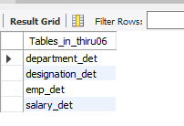

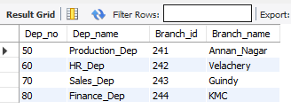
Show table
Commands:
Show tables;
Select * from Emp_det;
Insert Values
Commands:
insert into Department_det values
(50, 'Production_Dep', 241, 'Annan_Nagar'),(60, 'HR_Dep', 242, 'Velachery'),(70, 'Sales_Dep', 243, 'Guindy'),(80, 'Finance_Dep', 244, 'KMC');
select * from Department_det;

Slide 9
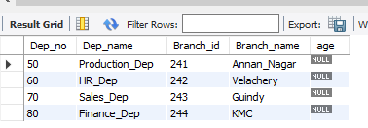
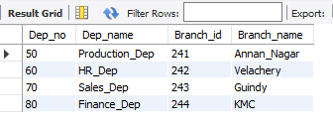
Drop Table
Commands: drop table Department_det;
Alter table
Command : alter table Department_det add age varchar(20);
Alter Table Modify:
Command: alter table Department_det modify age varchar(5);
Alter table Drop
Command: alter table Department_det drop column age;

Slide 10
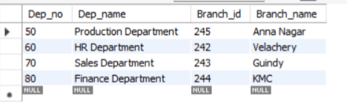

Alter table Rename (Rename the Table)
Command:- alter table Department_det Rename Dep_det;
Update Table ( To change the Values)
Command:- update Dep_det set Branch_id = 245 where Dep_no = 50;
Delete Statement
Command: Delete from Dep_det where Branch_id = 245;

Slide 11
My SQL General Functions
Where
Or
In
>
<
>=
<=
Not in
!
Count
Distinct
Count with distinct
Order by desc
Order by asc
Group by
Limit
Desc limit
Like
Not like
Between

Slide 12

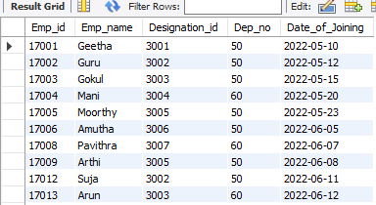
Where
Command: Select * from Emp_det where Emp_id= 17005;
Or
Command: Select * from Emp_det where Dep_no = 50 or Dep_no = 60;

Slide 13

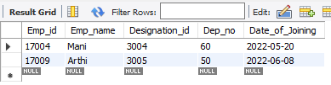
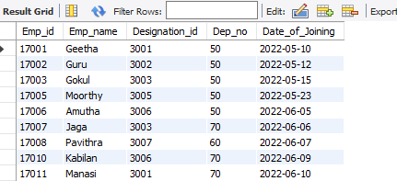
And
Command: Select * from Emp_det where Dep_no = 50 and Designation_id = 3005;
In
Command: select * from Emp_det where Emp_name in('Mani','Arthi');
Not in
Command: select * from Emp_det where Emp_name Not in ('Mani','Arthi');

Slide 14
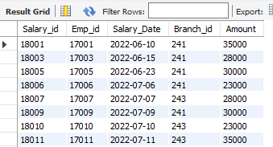
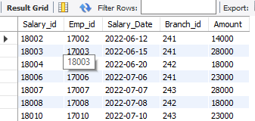
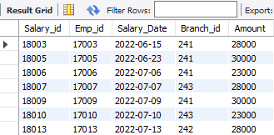
>
Command: select * from Salary_det where Amount > 20000 ;
<
Command: select * from Salary_det where Amount < 30000;
>= and <=
Command: select * from Salary_det where Amount >= 20000 and Amount <=30000;

Slide 15
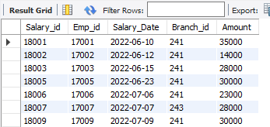
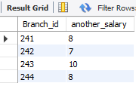

!
Command: Select * from Salary_det where Amount != 18000;
Count
Command: select Branch_id, Count(Amount) as another_salary from Salary_det group by Branch_id;
Distinct
Command: Select Distinct Amount from Salary_det;

Slide 16

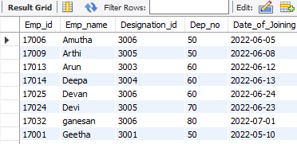
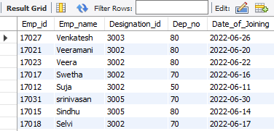
Count With Distinct
Command: Select count(Distinct Amount) from Salary_det;
Order by asc
Command: select * from Emp_det order by Emp_name asc;
Order by desc
Command: select * from Emp_det order by Emp_name desc;

Slide 17
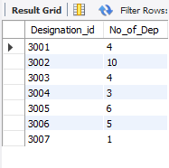
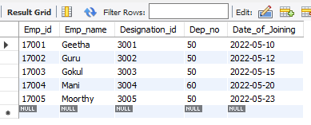
Group By
Command: Select Designation_id, count(Dep_no) as No_of_Dep from Emp_det group by Designation_id;
Limit
Command: select * from Emp_det limit 0,5;

Slide 18
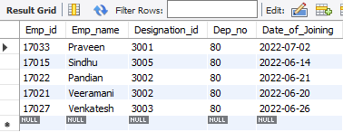
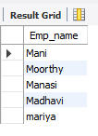
Desc Limit
Command: select * from Emp_det order by Dep_no Desc limit 0,5;
Like (_%)
Command: select Emp_name from Emp_det where Emp_name like‘m%';

Slide 19
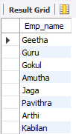
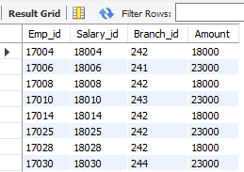
Not like
Command: select Emp_name from Emp_det where Emp_name not like‘m%';
Between
Command: select Emp_id,Salary_id, Branch_id, Amount from Salary_det where Amount between 15000 and 25000;

Slide 20
My SQL calculate functions
Sum
Average
Min
Max
Count

Slide 21





Sum
Command: select sum(amount) from salary_det;
Average
Command: select avg(amount) from salary_det;
Min
Command: select min(amount) from salary_det;
Max
Command: select max(amount) from salary_det;
Count
Command: select count(amount) from salary_det;

Slide 22
My SQL String Functions
Lcase
Ucase
Left
Right
Concat
Trim
Char_Length
Mid
Length

Slide 23
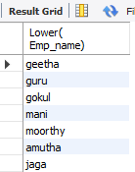
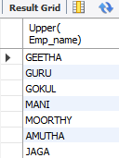
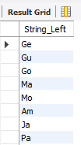
Lower
Command: select Lower( Emp_name) from Emp_det;
Upper
Command: select Upper( Emp_name) from Emp_det;
Left
Command: select Left(Emp_name, 2) as String_Left from Emp_det;

Slide 24
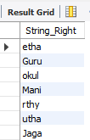
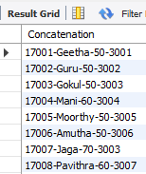
Right
Command: select Right(Emp_name, 4) as String_Right from Emp_det;
Concat
Command: select concat(Emp_id,"-", Emp_name,"-", Dep_no,"-",Designation_id) as Concatenation from Emp_det;

Slide 25

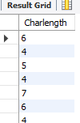
Trim
Command: select trim(Branch_id) as Trimmed from Salary_det;
Char_lenght
Command: select char_length(Emp_name) as Charlength from Emp_det;

Slide 26

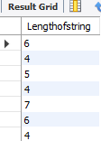
Mid
Command: select mid(Emp_name,1, 4) as MIDSTRING from Emp_det;
Lenght
Command: select length(Emp_name) as Lengthofstring from Emp_det;

Slide 27
My SQL Date Functions
Date ADD
Date diff
Timestamp Diff
Date Format
Year
Day
Month
Now

Slide 28

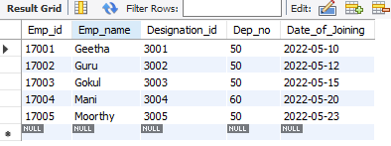
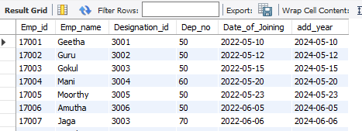
Date add
Command: select * from Emp_det where(Date_of_joining)='2022/05/12';
Month
Command: select * from Emp_det where month(Date_of_joining)='5';
Year
Command: select * , date_add(date_of_joining,interval 2 year) as add_year from emp_det;

Slide 29
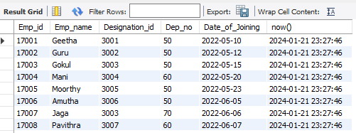
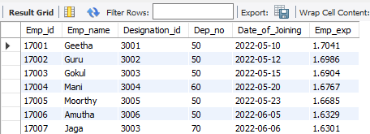
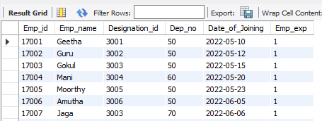
Now
Command: select * , now() from emp_det;
datediff
Command: select *, datediff(curdate(), date_of_join)/365as emp_exp from emp_det;
Timestampdiff
Command: select *, timestampdiff(year, Date_of_joining, sysdate()) as Emp_exp from Emp_det;

Slide 30
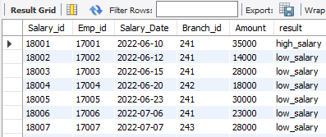
Logical Functions
IF
If with and conditons
If with or conditions
Count If
If
Command: select *, if(amount>=35000,'high_salary','low_salary') as result from Salary_det;

Slide 31
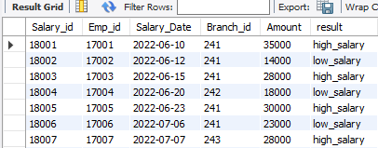
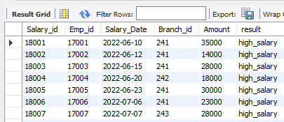
If with and condition
Command: Salary_det;select *, if((amount>=25000) and (Branch_id>=241),
'high_salary','low_salary') as result from Salary_det;
If with or condition
Command: select *, if((amount>=25000) or (Branch_id>=241),'high_salary','low_salary') as result from Salary_det;

Slide 32
RDBMS System
RDBMS stands for Relational Database Management System.
RDBMS is a program used to maintain a relational database.
RDBMS is the basis for all modern database systems such as MySQL, Microsoft SQL Server, Oracle, and Microsoft Access.
RDBMS uses SQL queries to access the data in the database.
Two table connection
Three table connection

Slide 33
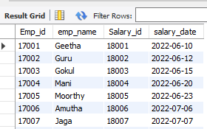
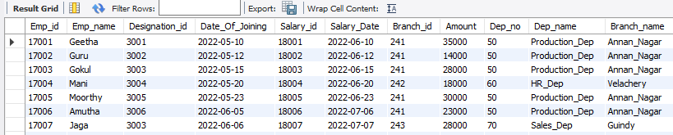
Two table connection
Command: select Emp_det.Emp_id, Emp_det.emp_name, Salary_det.Salary_id, salary_det.
salary_date from Emp_det inner join Salary_det on Emp_det.Emp_id = Salary_det.Emp_id;
Three table connection
Command: Select Emp_det.Emp_id,Emp_det.Emp_name,Emp_det.Designation_id,Emp_det. Date_Of_Joining,Salary_det.Salary_id,Salary_det.Salary_Date,Salary_det.Branch_id,Salary_det.Amount,Dep_det.
Dep_no,Dep_det.Dep_name,Dep_det.Branch_name from Emp_det inner join Salary_det on Emp_det.Emp_id = Salary_det.Emp_id inner join Dep_det on Emp_det.Dep_no = Dep_det.Dep_no;

Slide 34
Join Queries
Inner Join
Left Join
Right Join
Cross join
Full Outer Join
Case and end
when
Then
double case with end statement
case with and statement
case with or statement
RDBMS with subqueries
having clause
basic joins Trigger (Create table after connections)

Slide 35
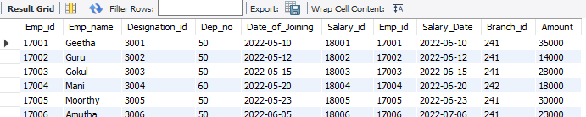
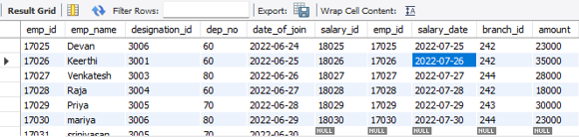
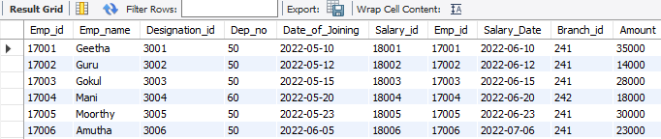
Inner join
Command: select * from Emp_det inner join Salary_det on Emp_det.Emp_id = Salary_det.Emp_id;
Left join
Command: select * from Emp_det left join Salary_det on Emp_det.Emp_id = Salary_det.Emp_id;
Right join
Command: select * from Emp_det right join Salary_det on Emp_det.Emp_id = Salary_det.Emp_id;

Slide 36
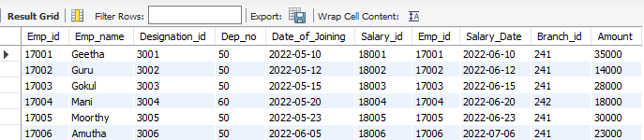
Full outer join
Command: (select * from Emp_det left join Salary_det on Emp_det.Emp_id = Salary_det.Emp_id)
union(select * from Emp_det right join Salary_det on Emp_det.Emp_id = Salary_det.Emp_id);

Slide 37
Procedures concepts
Procedure creation
Begins & end
call Procedures
Alter procedures
Declering variables
Store variables

Slide 38
Procedures concepts
Command:
delimiter //
create procedure Store_data2()
Begin
select *,case
when amount >= 35000 then ‘High salary’
when amount >= 25000 then ‘Average salary’
when amount >= 15000 then ‘low salary’
when amount >= 1000 then ‘Very Low salary
end as Salary_gradefrom Salary_det;
select * from Salary_det where amount = 30000;
select * from Salary_det where amount <= 15000;
end //
delimiter ;
call Store_data2;

Slide 39
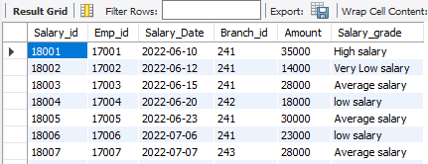
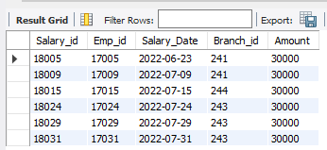
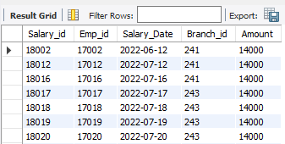

Slide 40
Triggers
What is trigger
A database trigger is a stored program which is automatically fired or executed when some events occur.
Types of Trigger
Row level Trigger - A event is triggered at row level for each row updated, inserted or deleted.
Statement Level trigger - An event is triggered at table Level for each sql statement executed

Slide 41
Triggers Timing
before insert
after insert
before update
after update
before delete
after delete

Slide 42
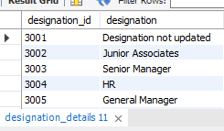
Before insert
Command: delimiter //
create trigger Emp_det
before insert on Designation_det
for each row
if new.Designation is null then set new.Designation= "Designation not updated";
end if //
delimiter ;
delete from Designation_det where Designation_id (3001,3002);
insert into Designation_det values (3001, null),(3002,null);
select * from Designation_det;
drop trigger Emp_det;

Slide 43
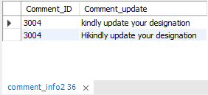
After insert
Command: delete from des_det where designation_id in(3003,3004,3005);
create table Comment_info(Comment_ID int, Comment_update varchar(100));
delimiter //
create trigger designation_update after insert on des_det for each row
begin
if new.designation is null then insert into Comment_info (Comment_id,Comment_update) values (new.designation_id,concat('Hi','kindly update your designation'));
end if;
end //
delimiter ;
insert into des_det values (3003,'Senior Manager'),(3004, null),(3005,'General Manager');
select * from des_det;
select * from comment_info;

Slide 44
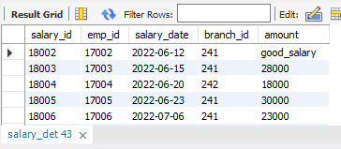
Before update
Command: drop table sal_det;
select * from sal_det;
delimiter //
create trigger Update_sal before updateon sal_det for each row
Begin
if new.amount >=35000 then set new.amount = "High_salary";
elseif new.amount >= 20000 thenset new.amount = "good_salary";
elseif new.amount >= 10000 thenset new.amount= "average_salary";
elseif new.amount >= 0 thenset new.amount = "low_salary";
end if;
end//
delimiter ;
update sal_det set amount = 20000 where salary_id = 18002;
select * from sal_det;

Slide 45
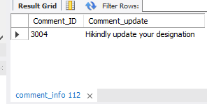
After update
Command: create table Salary_grade1 (sal_id int, grade varchar(100));
delimiter //
create trigger Update_salary1 after updateon sal_det for each row
Begin
if new.amount >=40000 then insert into salary_grade1 (sal_id, grade) values(new.emp_id,"High_salary");
elseif new.amount >=35000 then insert into salary_grade1 (sal_id, grade) values(new.emp_id,"Good_salary");
elseif new.amount >=15000 then insert into salary_grade1 (sal_id, grade)values(new.emp_id,"avg_salary");
elseif new.amount >= 0 then insert into salary_grade1(sal_id, grade)values(new.emp_id,"Low_salary");
end if;
end //
delimiter ;
update sal_det set amount = 45000 where emp_id = 17004;
select * from sal_det;
select * from salary_grade1;

Slide 46

Before delete
Command: create table dep_det1(dep_no int,dep_name varchar(20),branch_id int,branch_name varchar(20),primary key(dep_no));
alter table dep_det modify dep_name varchar(40);
delimiter //
create trigger del_department3 before delete on dep_det for each row
BEGIN
insert into dep_det1(dep_no,dep_name,branch_id,branch_name)values(old.dep_no,old.dep_name,old.branch_id,old.branch_name);
end //
delimiter ;
select * from dep_det;
select * from dep_det1;
delete from dep_det where dep_no = 60;

Slide 47
After delete
Command: create table dep_det2(dep_no int,dep_name varchar(20),branch_id int,branch_name varchar(20),primary key(dep_no));
delimiter //
create trigger del_dept1 after delete on dep_det for each row
BEGIN
insert into dep_det2(dep_no,dep_name,branch_id,branch_name)values(old.dep_no,old.dep_name,old.branch_id,old.branch_name);
end //
delimiter ;
select * from dep_det;
select * from dep_det2;
delete from dep_det where dep_no = 70;

Slide 48
THANK YOU

